Slide 1
DATA REDUCTION And TransformationS
DATA COLLECTION AND DATA PROCESSING

Slide 2
Learning Objectives
Familiarity with the following concepts:
Dimensionality of data
Curse of Dimensionality
Feature selection
Principal Component Analysis (PCA)
Data transformation
Scaling
Discretization

Slide 3
Dimensionality of Data
In data analysis, the dimension of the data is the number of variables (or attributes) that are collected in a dataset, represented by the number of columns.
Here the term dimension is an extension of the use of the term to refer to the size of a vector.
We can think of the number of variables used to describe each object (row) as a vector describing that object.
(Note – the term dimension is used differently in business intelligence contexts)

Slide 4
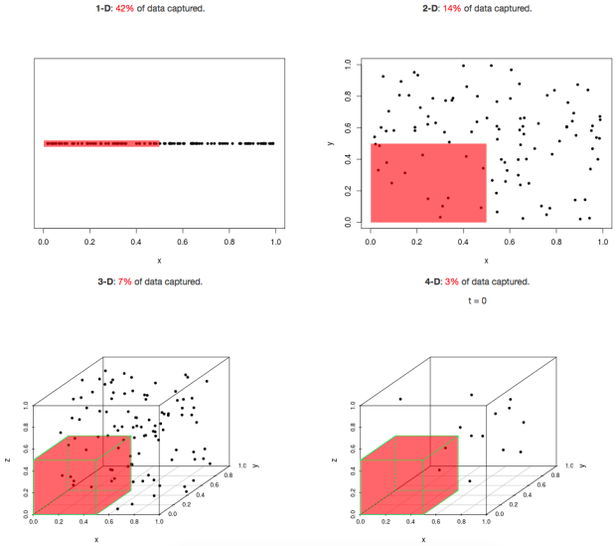
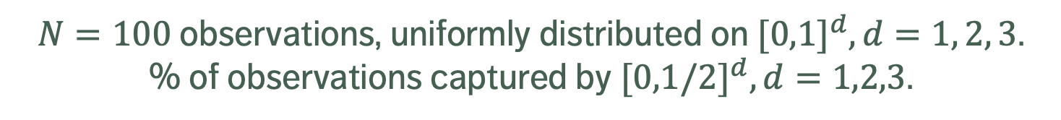
Curse of Dimensionality
[simplystatistics.org]
42% of data is captured
14% of data is captured
7% of data is captured
$N=100$observations, uniformly distributed on ${[0,1]}^{d}, d=1, 2, 3$.
% of observations captured by ${[0,1/2]}^{d},d=1,2,3$.

Slide 5
Sampling Observations
Question: does every row of the dataset need to be used?
If rows are selected randomly (with or without replacement), the resulting sample might be representative of the entire dataset.
Drawbacks:
if the signal of interest is rare, sampling might drown it altogether
if aggregation is happening down the road, sampling will necessarily affect the numbers (passengers vs. flights)
even simple operations on a large file (finding the # of lines, say) can be taxing on the memory and in terms of computation time – prior information on the dataset structure can help

Slide 6
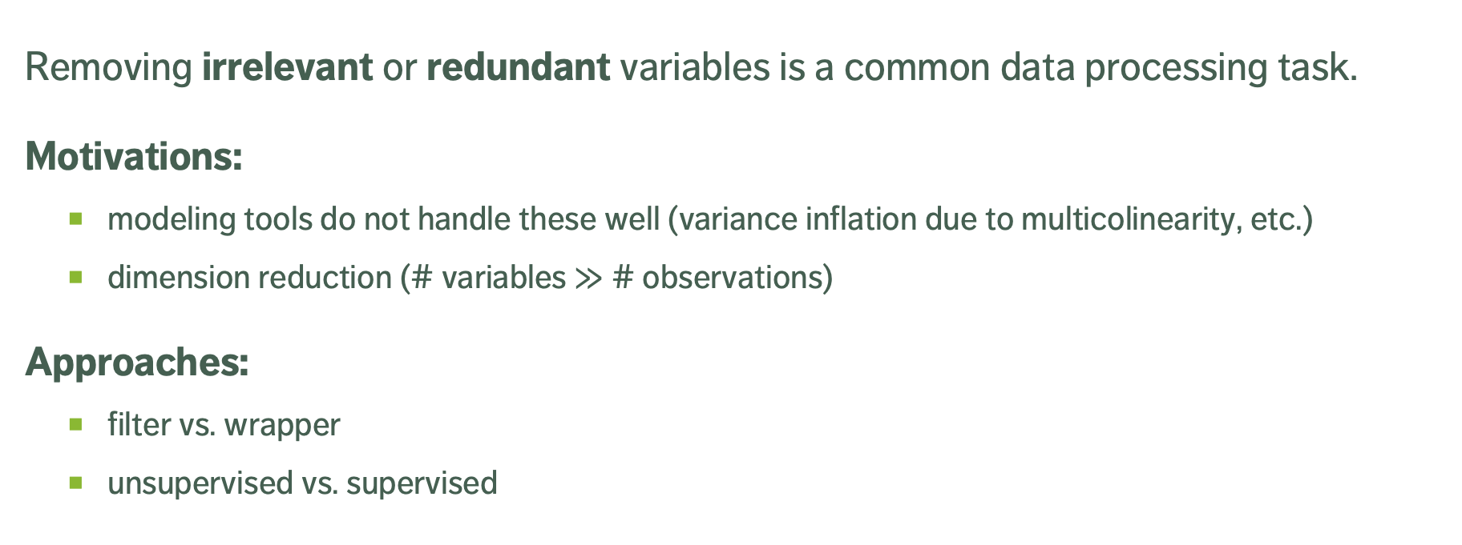
Feature Selection
Removing irrelevant or redundant variables is a common data processing task.
Motivations:
modeling tools do not handle these well (variance inflation due to multicolinearity, etc.)
dimension reduction (# variables $≫$ # observations)
Approaches:
filter vs. wrapper
unsupervised vs. supervised

Slide 7
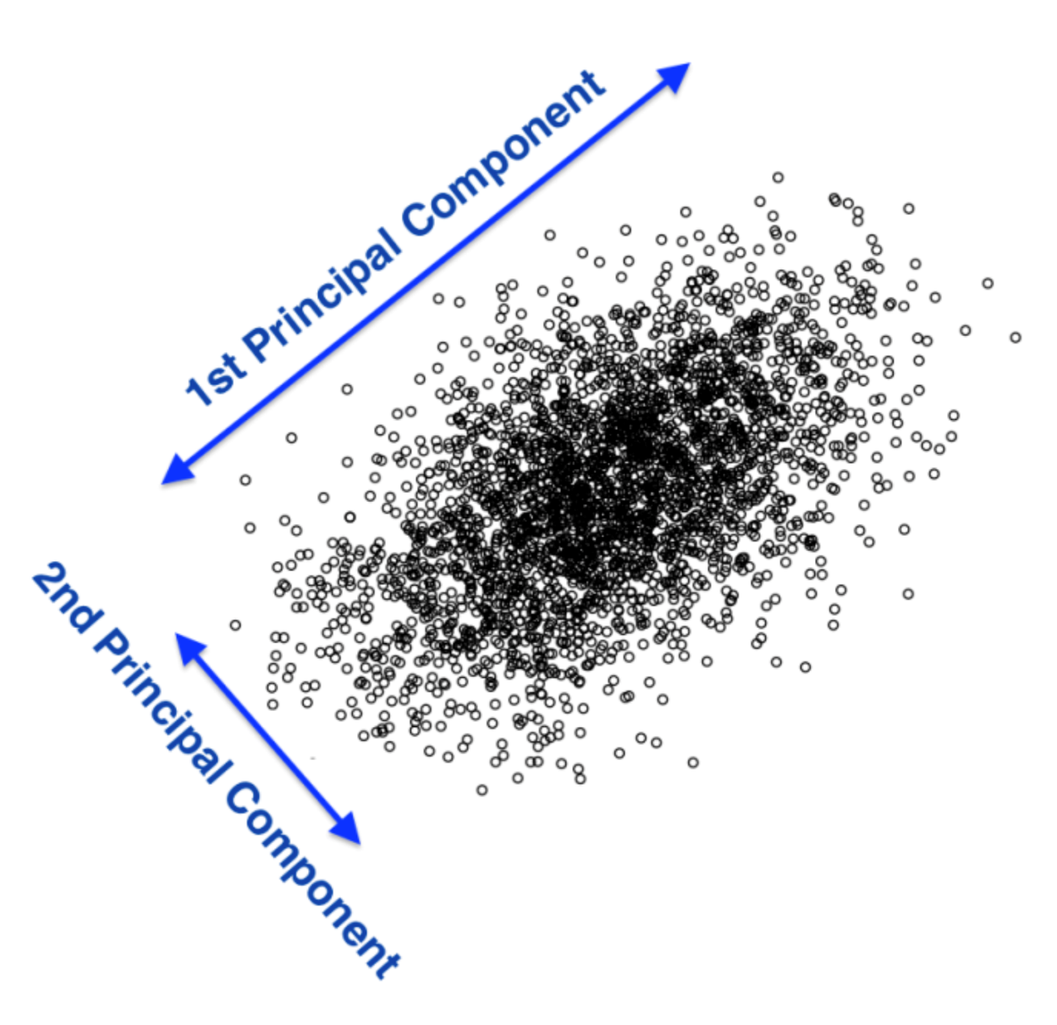
Principal Component Analysis
[A. Ng, K. Soo, Numsense!]
Motivational Example: Nutritional Content of Food
What is the best way to differentiate food items? Vitamin content, fat, or protein level? A bit of each?
Principal Component Analysis (PCA) can be used to find the combinations of variables along which the data points are most spread out.

Slide 8
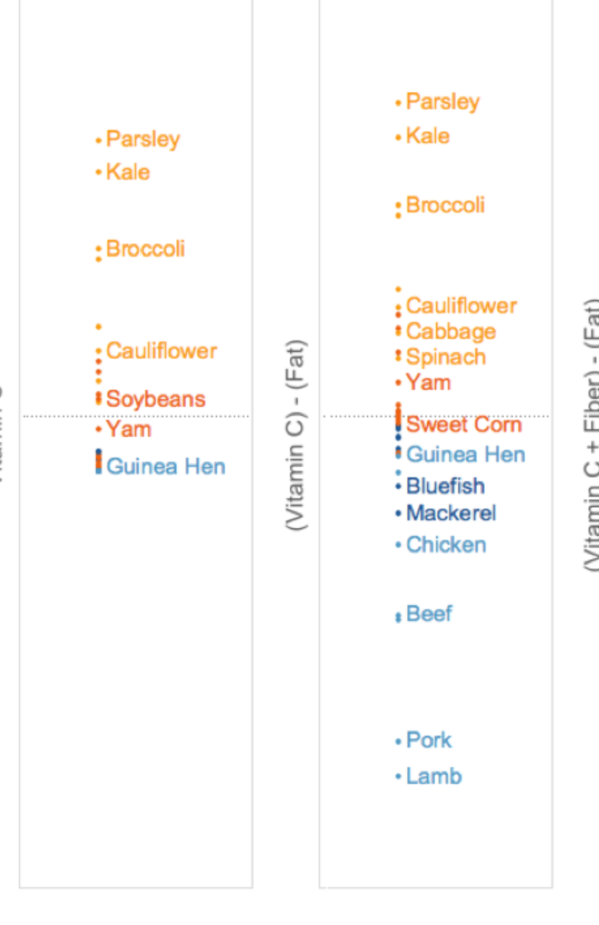
Differentiation
[A. Ng, K. Soo, Numsense!]
Vitamin C is present in various levels in fruit and vegetables, but not in meats. It separates vegetables from meats, and specific vegetables from one another (to some extent), but the meats are clumped together (left).
The situation is reversed for Fat levels, so the combination of vitamin C and fat separates vegetables from meats, and spreads vegetables and meats (right).
Vitamin C
Vitamin C - Fat

Slide 9
Common Transformations
Models sometimes require that certain data assumptions be met (normality of residuals, linearity, etc.).
If the raw data does not meet the requirements, we can either
abandon the model
attempt to transform the data
The second approach requires an inverse transformation to be able to draw conclusions about the original data.

Slide 10
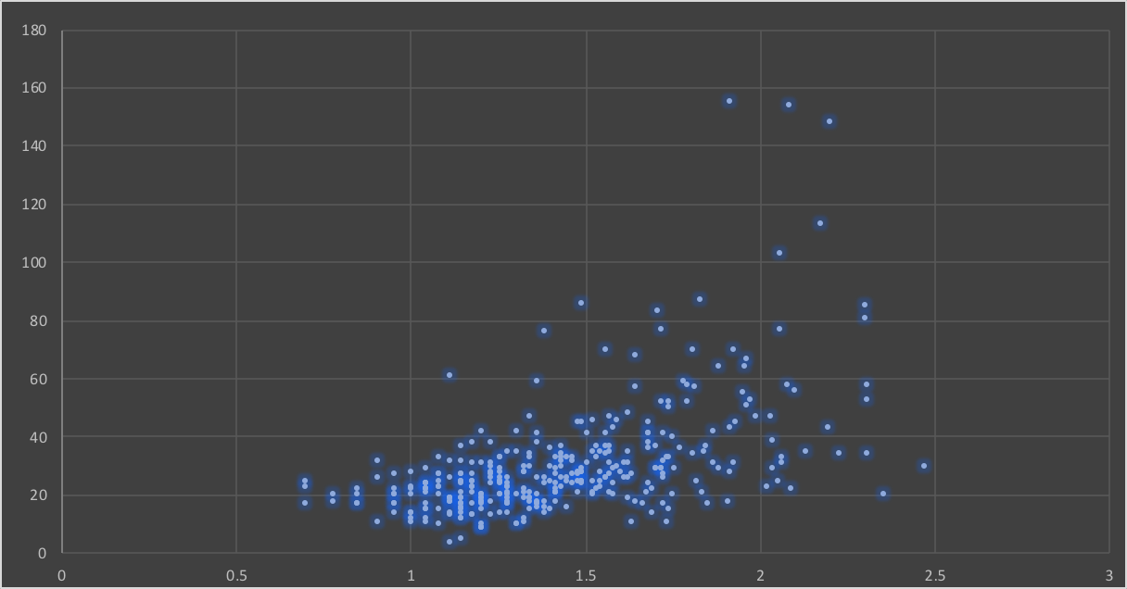
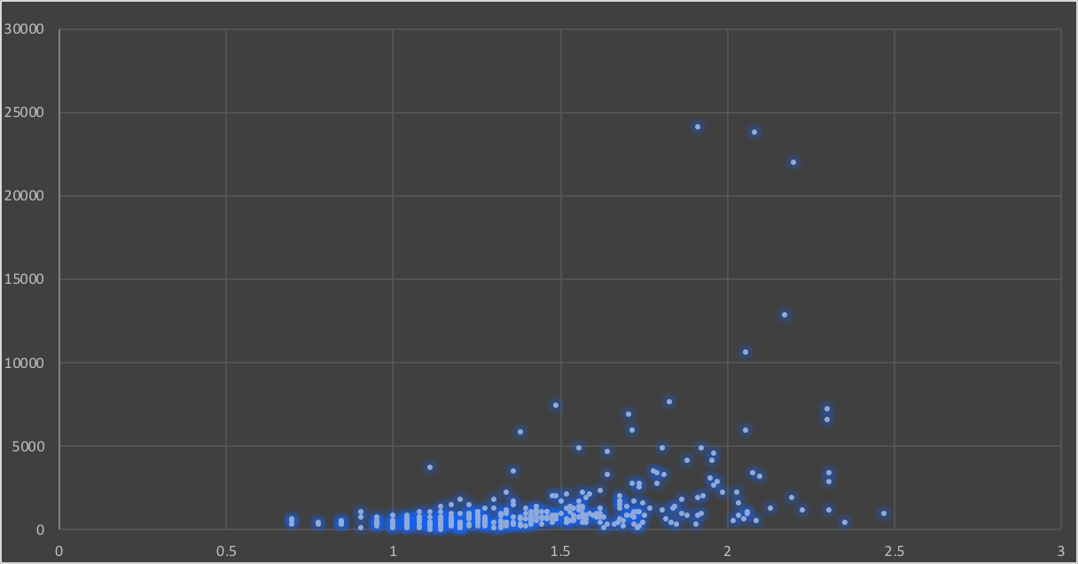
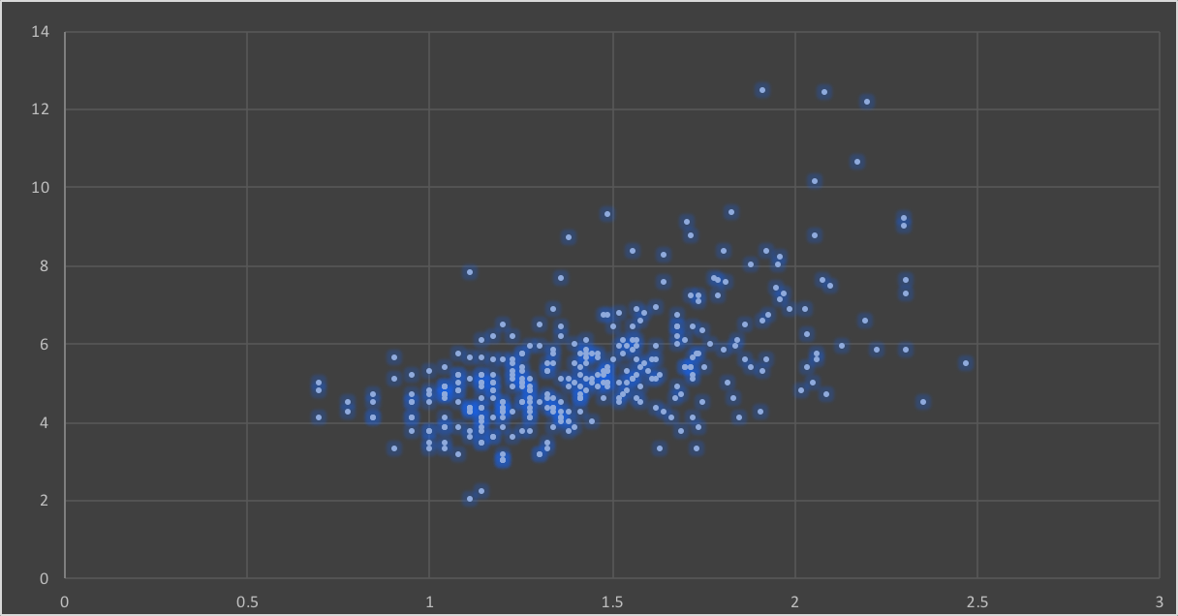
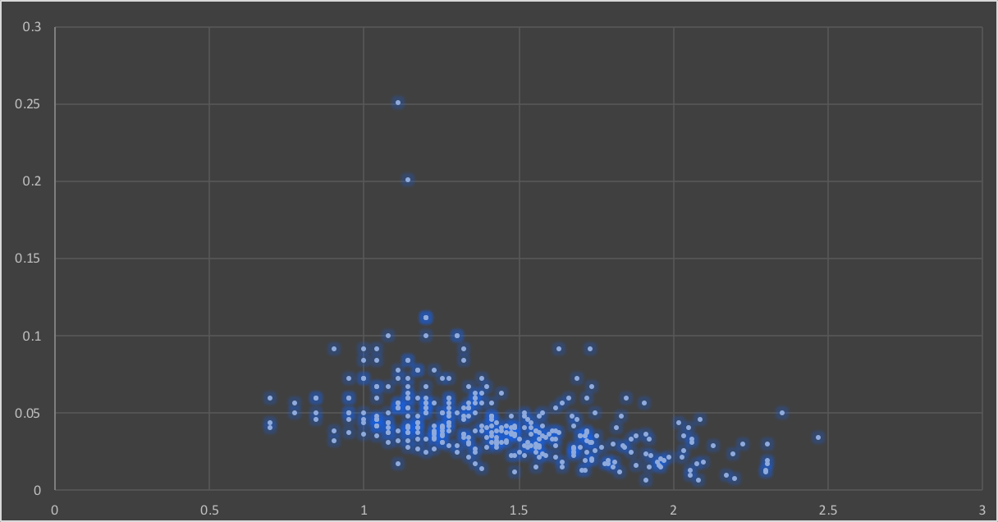
Original Data
Square
Square Root
Reciprocal

Slide 11
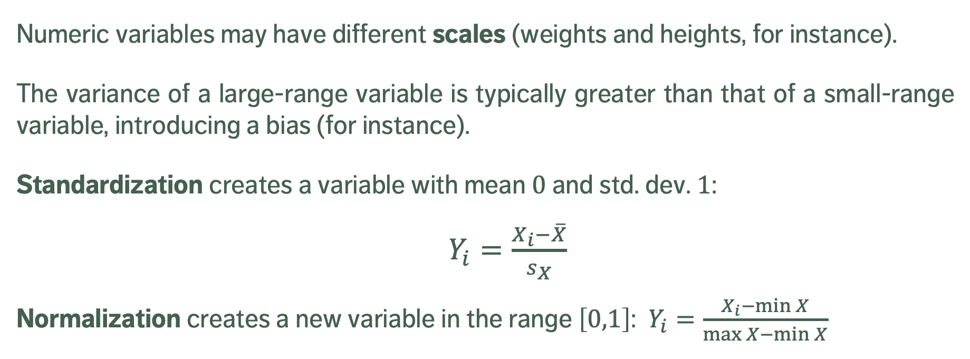
Scaling
Numeric variables may have different scales (weights and heights, for instance).
The variance of a large-range variable is typically greater than that of a small-range variable, introducing a bias (for instance).
Standardization creates a variable with mean $0$ and std. dev. $1$:
$Y_{i}=\frac{X_{i}−\overline{X}}{s_{X}}$
Normalization creates a new variable in the range $\left[0,1\right]$: $Y_{i}=\frac{X_{i}−\min{X}}{\max{X−\min{X}}}$

Slide 12
Discretizing
To reduce computational complexity, a numeric variable may need to be replaced by an ordinal variable (from height value to “short”, “average”, “tall”, for instance).
Domain expertise can be used to determine the bins’ limits (although that could introduce unconscious bias to the analyses)
In the absence of such expertise, limits can be set so that either
the bins each contain the same number of observations
the bins each have the same width
the performance of some modeling tool is maximized

Slide 13
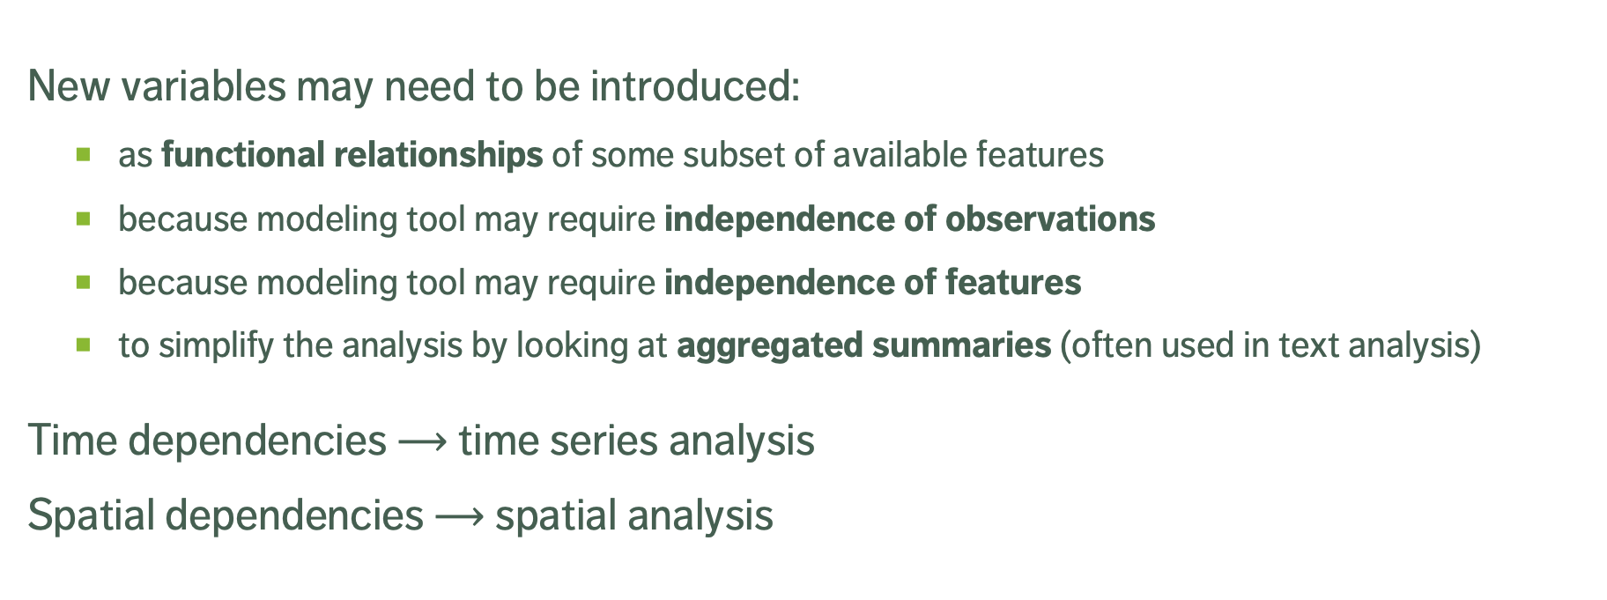
Creating Variables
New variables may need to be introduced:
as functional relationships of some subset of available features
because modeling tool may require independence of observations
because modeling tool may require independence of features
to simplify the analysis by looking at aggregated summaries (often used in text analysis)
Time dependencies $⟶$ time series analysis
Spatial dependencies $⟶$ spatial analysis

Slide 14
Supplemental Material

Slide 15
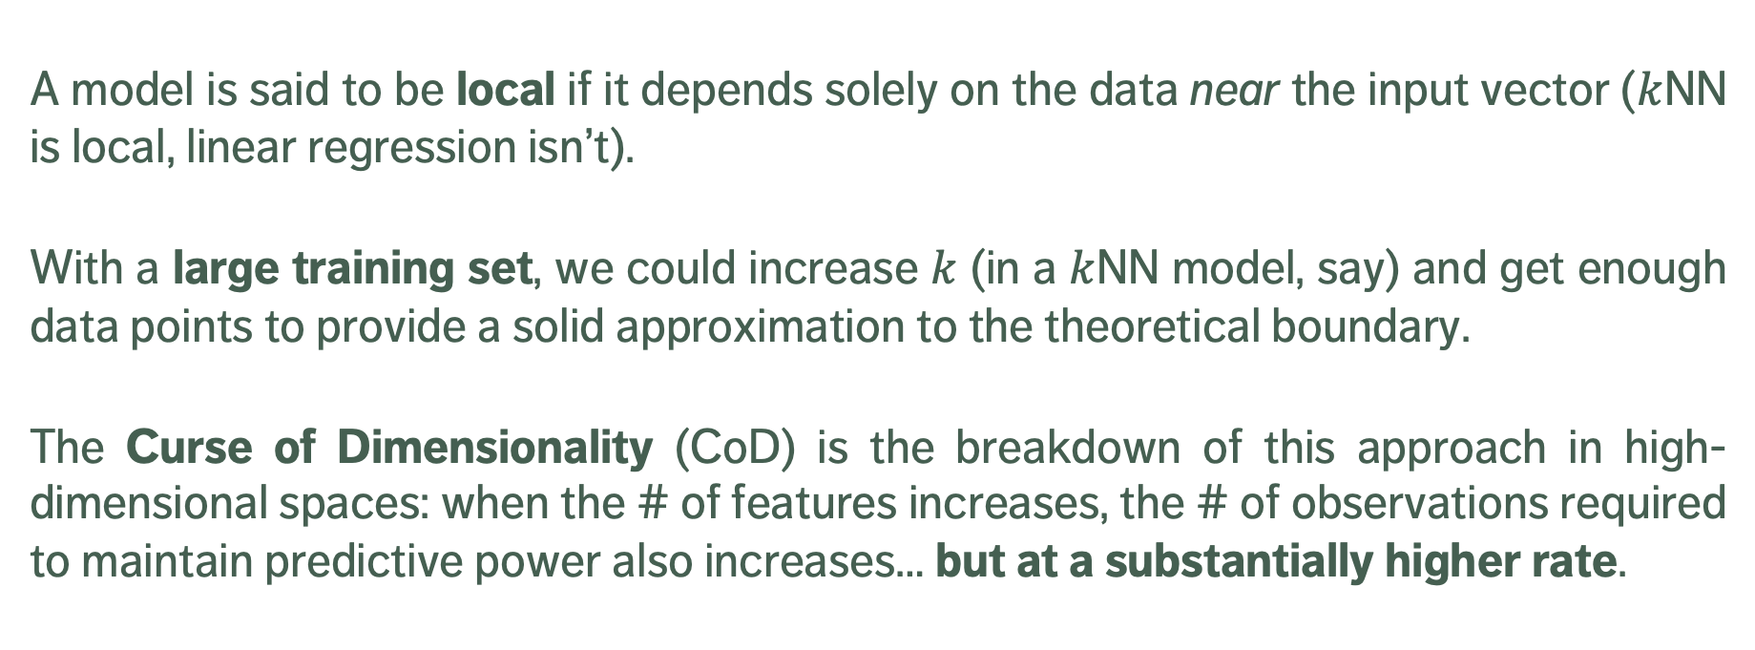
Local Methods in High Dimensions
A model is said to be local if it depends solely on the data near the input vector ($k$NN is local, linear regression isn’t).
With a large training set, we could increase $k$ (in a $k$NN model, say) and get enough data points to provide a solid approximation to the theoretical boundary.
The Curse of Dimensionality (CoD) is the breakdown of this approach in high-dimensional spaces: when the # of features increases, the # of observations required to maintain predictive power also increases… but at a substantially higher rate.

Slide 16
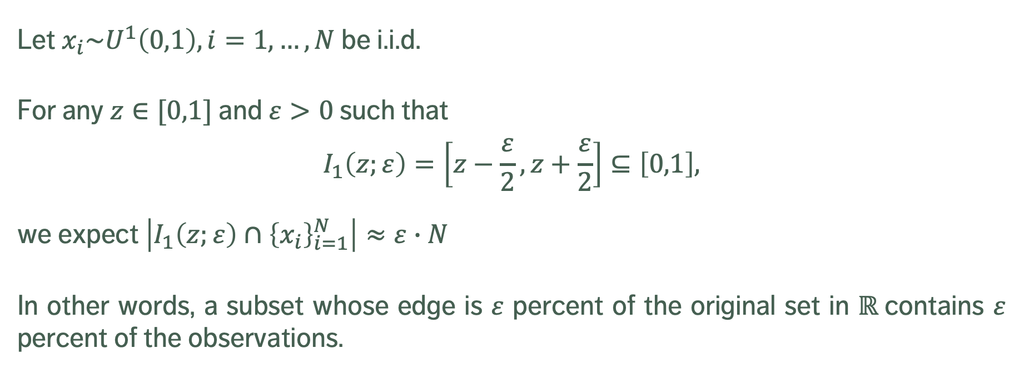
Manifestations of CoD
Let $x_{i}\sim U^{1}\left(0,1\right), i=1,…,N$ be i.i.d.
For any $z∈[0,1]$ and $ε>0$ such that
$$I_{1}\left(z;ε\right)=\left[z−\frac{ε}{2},z+\frac{ε}{2}\right]⊆\left[0,1\right],$$
we expect $\left|I_{1}\left(z;ε\right)∩{\left\{x_{i}\right\}}_{i=1}^{N}\right|≈ε∙N$
In other words, a subset whose edge is $ε$ percent of the original set in $ℝ$contains $ε$ percent of the observations.

Slide 17
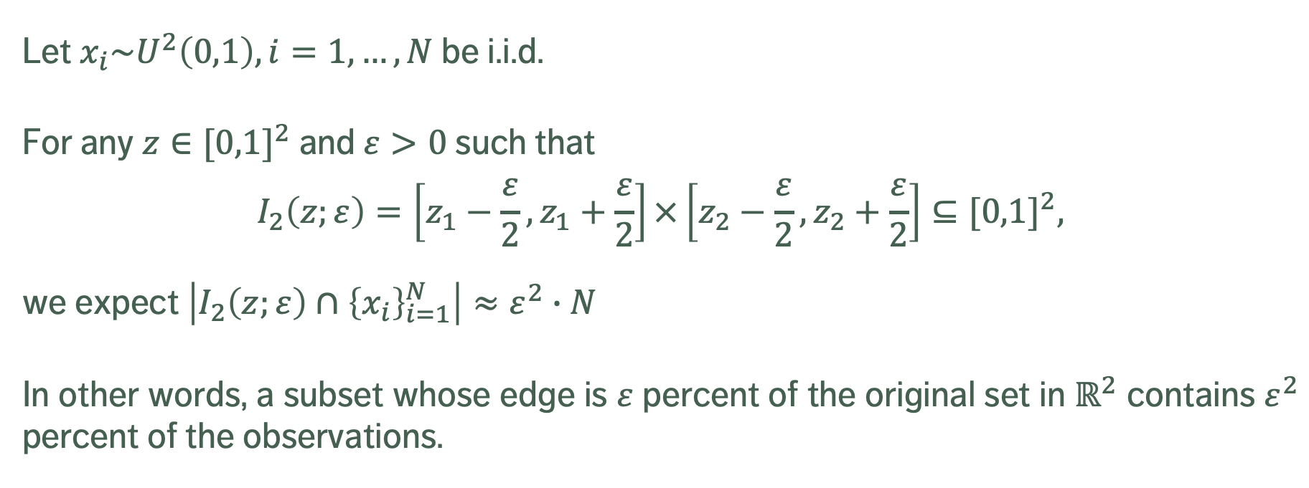
Manifestations of CoD
Let $x_{i}\sim U^{2}\left(0,1\right), i=1,…,N$ be i.i.d.
For any $z∈{[0,1]}^{2}$ and $ε>0$ such that
$$I_{2}\left(z;ε\right)=\left[z_{1}−\frac{ε}{2},z_{1}+\frac{ε}{2}\right]×\left[z_{2}−\frac{ε}{2},z_{2}+\frac{ε}{2}\right]⊆{[0,1]}^{2},$$
we expect $\left|I_{2}\left(z;ε\right)∩{\left\{x_{i}\right\}}_{i=1}^{N}\right|≈ε^{2}∙N$
In other words, a subset whose edge is $ε$ percent of the original set in $ℝ^{2}$ contains $ε^{2}$ percent of the observations.

Slide 18
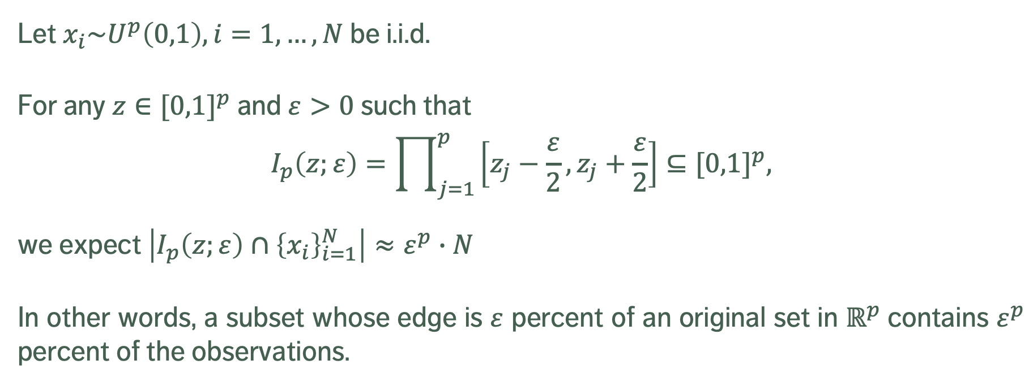
Manifestations of CoD
Let $x_{i}\sim U^{p}\left(0,1\right), i=1,…,N$ be i.i.d.
For any $z∈{[0,1]}^{p}$ and $ε>0$ such that
$$I_{p}\left(z;ε\right)=\prod_{j=1}^{p}{\left[z_{j}−\frac{ε}{2},z_{j}+\frac{ε}{2}\right]}⊆{[0,1]}^{p},$$
we expect $\left|I_{p}\left(z;ε\right)∩{\left\{x_{i}\right\}}_{i=1}^{N}\right|≈ε^{p}∙N$
In other words, a subset whose edge is $ε$ percent of an original set in $ℝ^{p}$contains $ε^{p}$ percent of the observations.

Slide 19
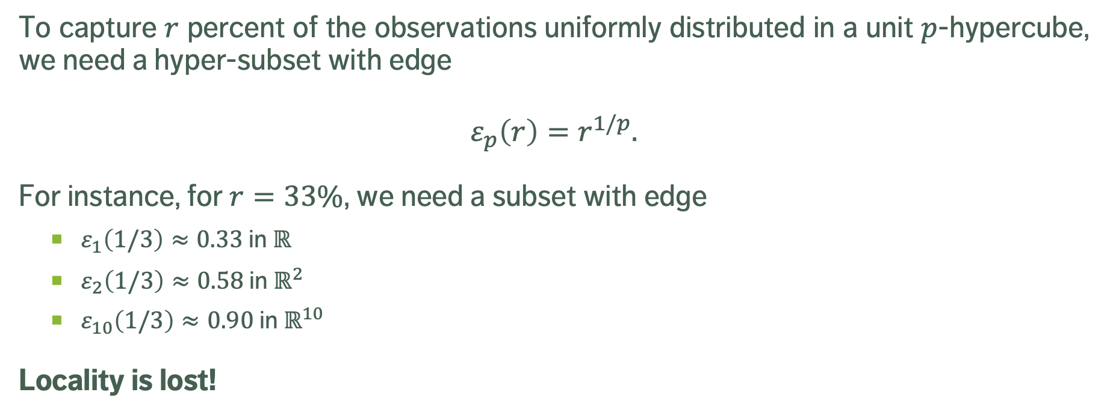
Manifestations of CoD
To capture $r$ percent of the observations uniformly distributed in a unit $p$-hypercube, we need a hyper-subset with edge
$$ε_{p}\left(r\right)=r^{1/p}.$$
For instance, for $r=33\%$, we need a subset with edge
$ε_{1}\left(1/3\right)≈0.33$ in $ℝ$
$ε_{2}\left(1/3\right)≈0.58$ in $ℝ^{2}$
$ε_{10}\left(1/3\right)≈0.90$ in $ℝ^{10}$
Locality is lost!

Slide 20
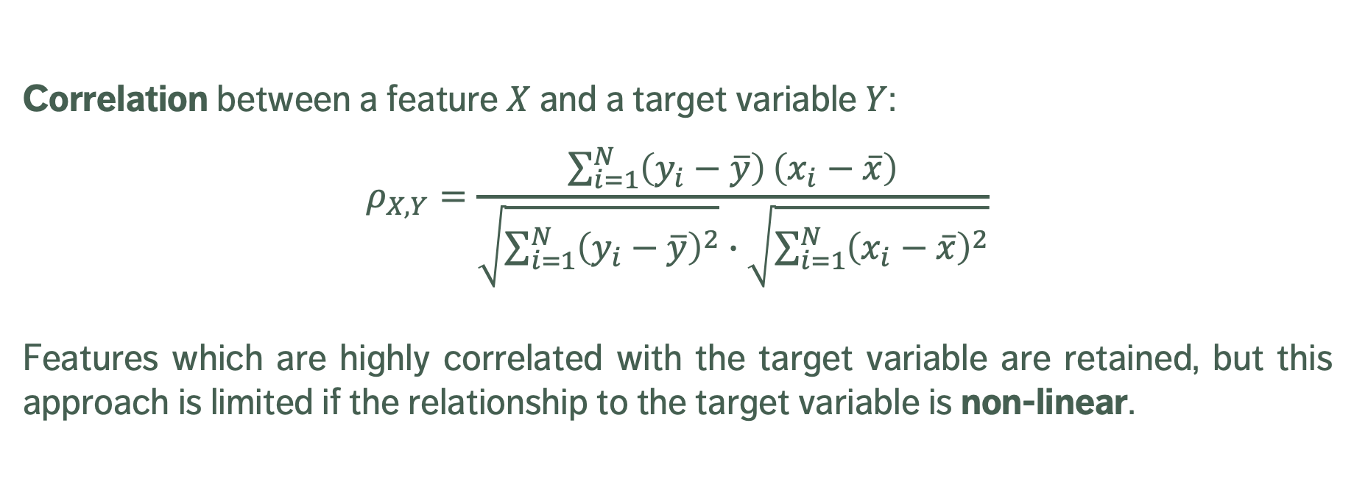
Supervised Filter Methods
Correlation between a feature $X$ and a target variable $Y$:
$$ρ_{X,Y}=\frac{\sum_{i=1}^{N}{\left(y_{i}−\overline{y}\right)}\left(x_{i}−\overline{x}\right)}{\sqrt{\sum_{i=1}^{N}{{\left(y_{i}−\overline{y}\right)}^{2}}}∙\sqrt{\sum_{i=1}^{N}{{\left(x_{i}−\overline{x}\right)}^{2}}}}$$
Features which are highly correlated with the target variable are retained, but this approach is limited if the relationship to the target variable is non-linear.

Slide 21
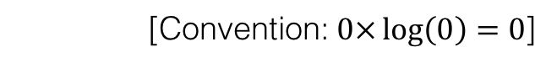
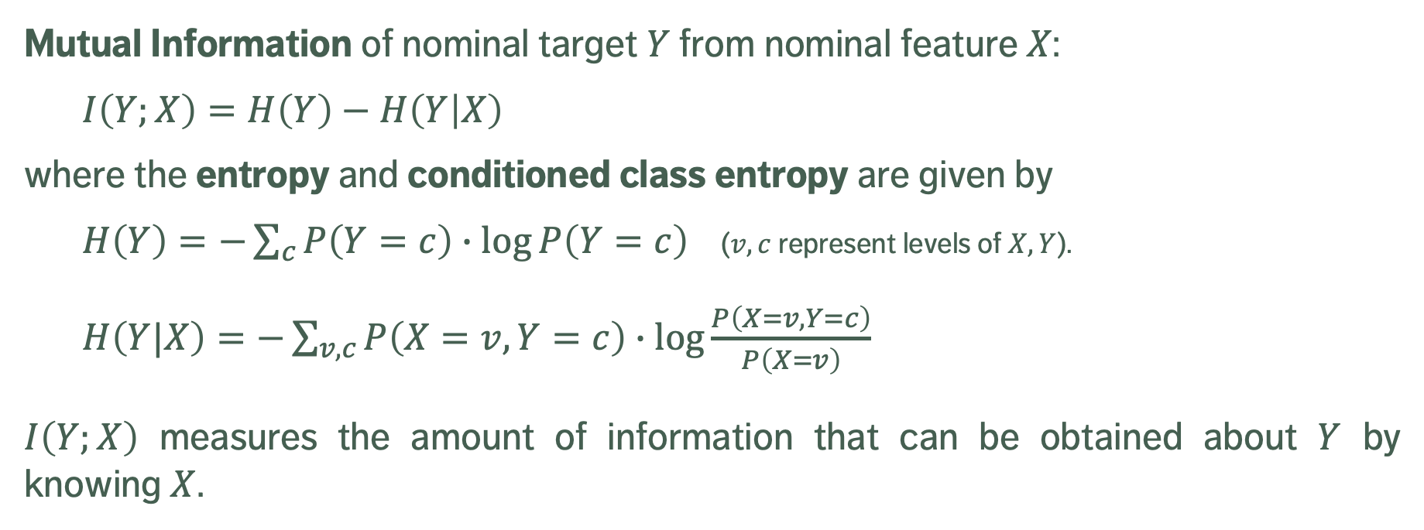
Supervised Filter Methods
Mutual Information of nominal target $Y$ from nominal feature $X$:
$I\left(Y;X\right)=H\left(Y\right)−H\left(Y | X\right)$
where the entropy and conditioned class entropy are given by
$H\left(Y\right)=−\sum_{c}{P\left(Y=c\right)∙\log{P\left(Y=c\right)}}$ ($v,c$ represent levels of $X,Y$).
$H\left(Y|X\right)=−\sum_{v,c}{P\left(X=v,Y=c\right)}$ $∙\log{\frac{P\left(X=v,Y=c\right)}{P\left(X=v\right)}}$
$I\left(Y;X\right)$ measures the amount of information that can be obtained about $Y$ by knowing $X$.
[Convention: $0×\log\left(0\right)=0$]

Slide 22
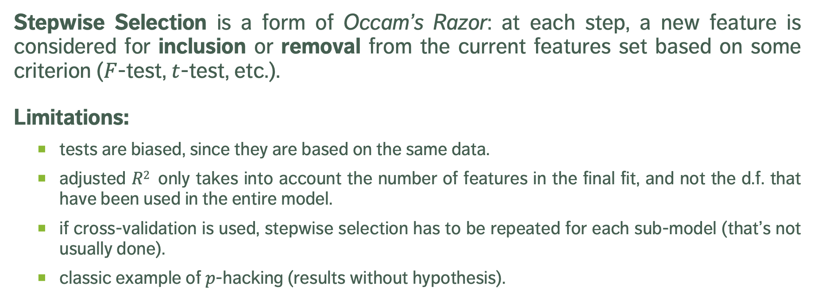
LASSO and Variants
Stepwise Selection is a form of Occam’s Razor: at each step, a new feature is considered for inclusion or removal from the current features set based on some criterion ($F$-test, $t$-test, etc.).
Limitations:
tests are biased, since they are based on the same data.
adjusted $R2$ only takes into account the number of features in the final fit, and not the d.f. that have been used in the entire model.
if cross-validation is used, stepwise selection has to be repeated for each sub-model (that’s not usually done).
classic example of $p$-hacking (results without hypothesis).

Slide 23
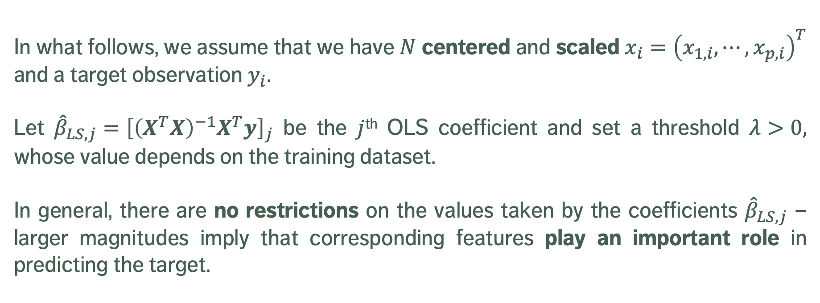
LASSO and Variants
In what follows, we assume that we have $N$ centered and scaled $x_{i}={\left(x_{1,i},⋯,x_{p,i}\right)}^{T}$ and a target observation $y_{i}$.
Let ${\hat{β}}_{LS,j}={\left[{\left(X^{T}X\right)}^{−1}X^{T}y\right]}_{j}$ be the $j$^{th} OLS coefficient and set a threshold $λ>0,$ whose value depends on the training dataset.
In general, there are no restrictions on the values taken by the coefficients ${\hat{β}}_{LS,j}$ – larger magnitudes imply that corresponding features play an important role in predicting the target.

Slide 24
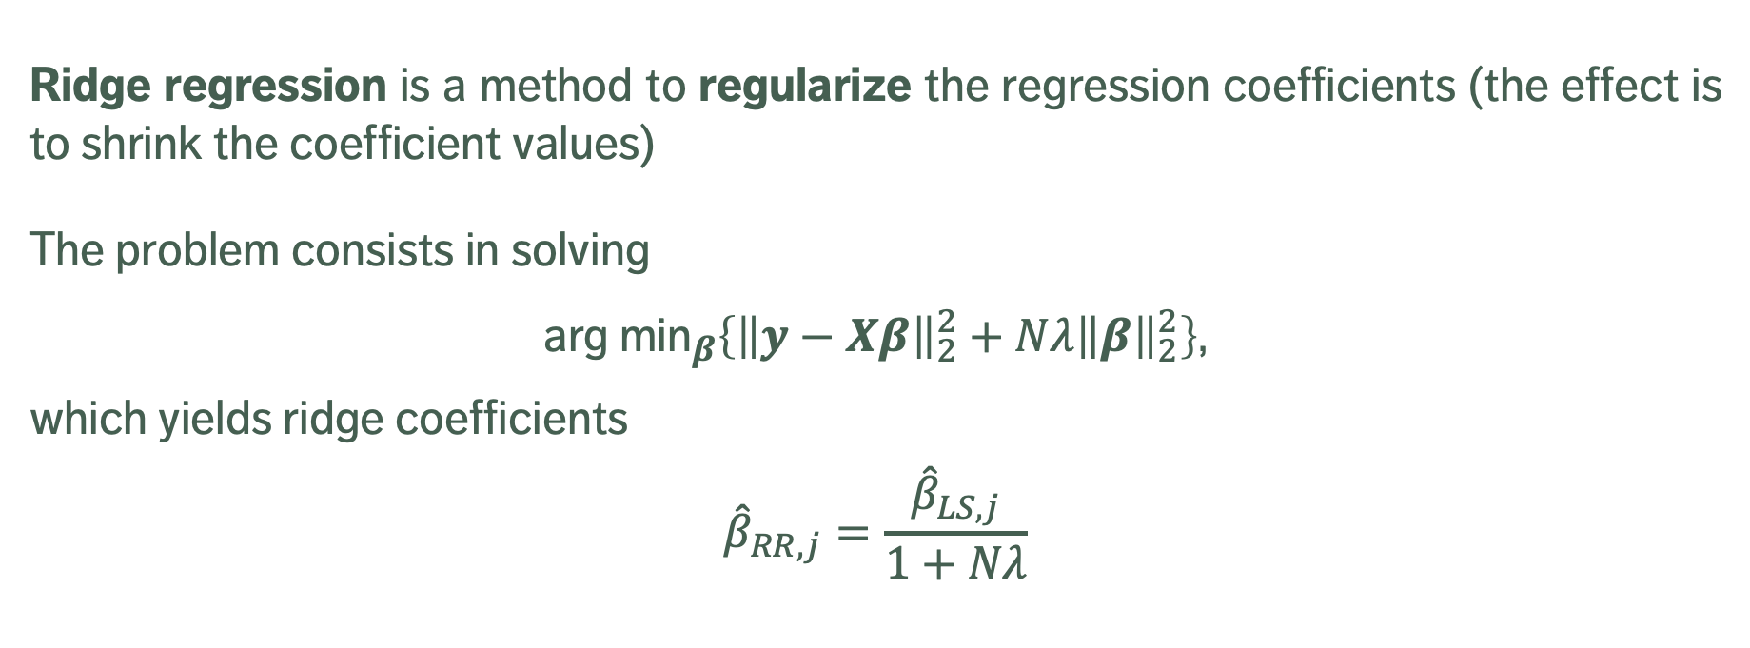
LASSO and Variants
Ridge regression is a method to regularize the regression coefficients (the effect is to shrink the coefficient values)
The problem consists in solving
${\text{arg} \text{min}}_{β}\left\{{\left\|y−Xβ\right\|}_{2}^{2}+Nλ{\left\|β\right\|}_{2}^{2}\right\}$,
which yields ridge coefficients
$${\hat{β}}_{RR,j}=\frac{{\hat{β}}_{LS,j}}{1+Nλ}$$

Slide 25
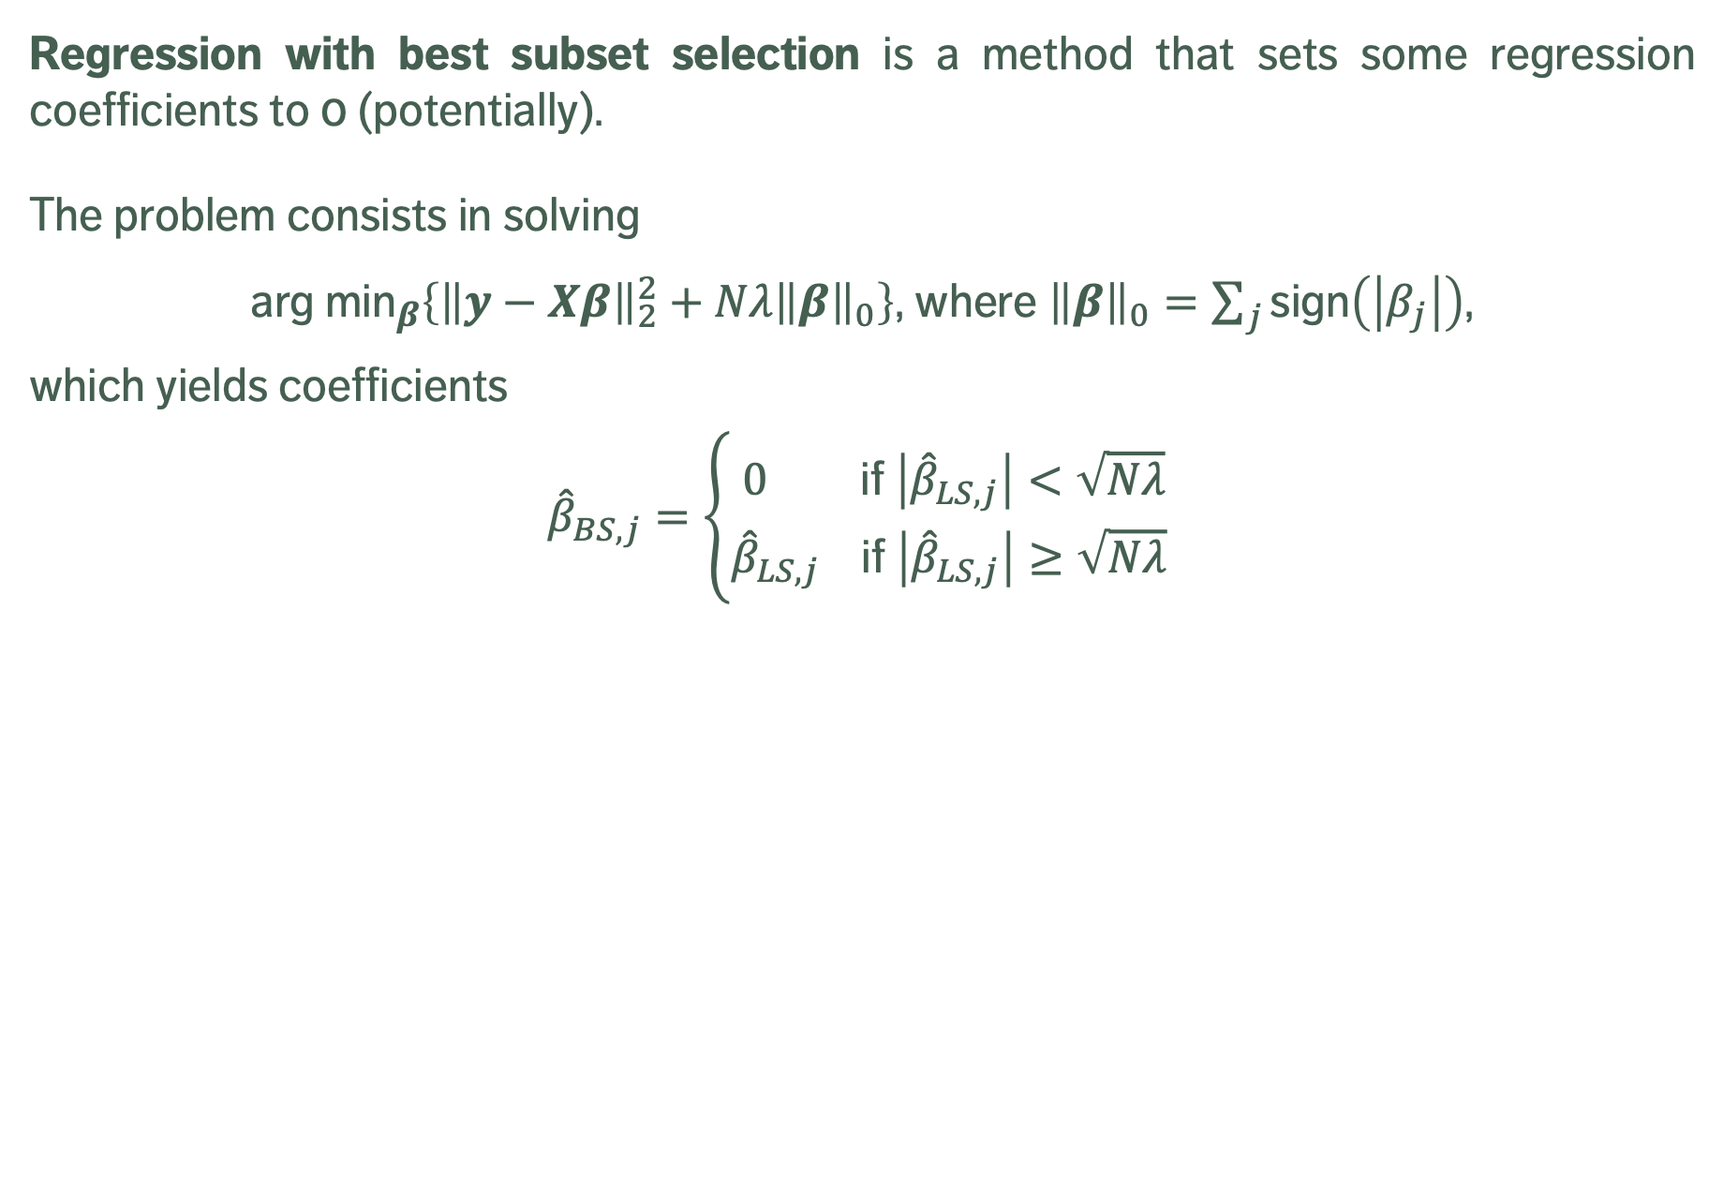
LASSO and Variants
Regression with best subset selection is a method that sets some regression coefficients to 0 (potentially).
The problem consists in solving
${\text{arg} \text{min}}_{β}\left\{{\left\|y−Xβ\right\|}_{2}^{2}+Nλ{\left\|β\right\|}_{0}\right\}$, where ${\left\|β\right\|}_{0}=\sum_{j}{\text{sign}\left(\left|β_{j}\right|\right)}$,
which yields coefficients
$${\hat{β}}_{BS,j}=\left\{\begin{matrix}0 \text{if} \left|{\hat{β}}_{LS,j}\right|<\sqrt{Nλ} \\ {\hat{β}}_{LS,j} \text{if} \left|{\hat{β}}_{LS,j}\right|≥\sqrt{Nλ} \end{matrix}\right.$$

Slide 26
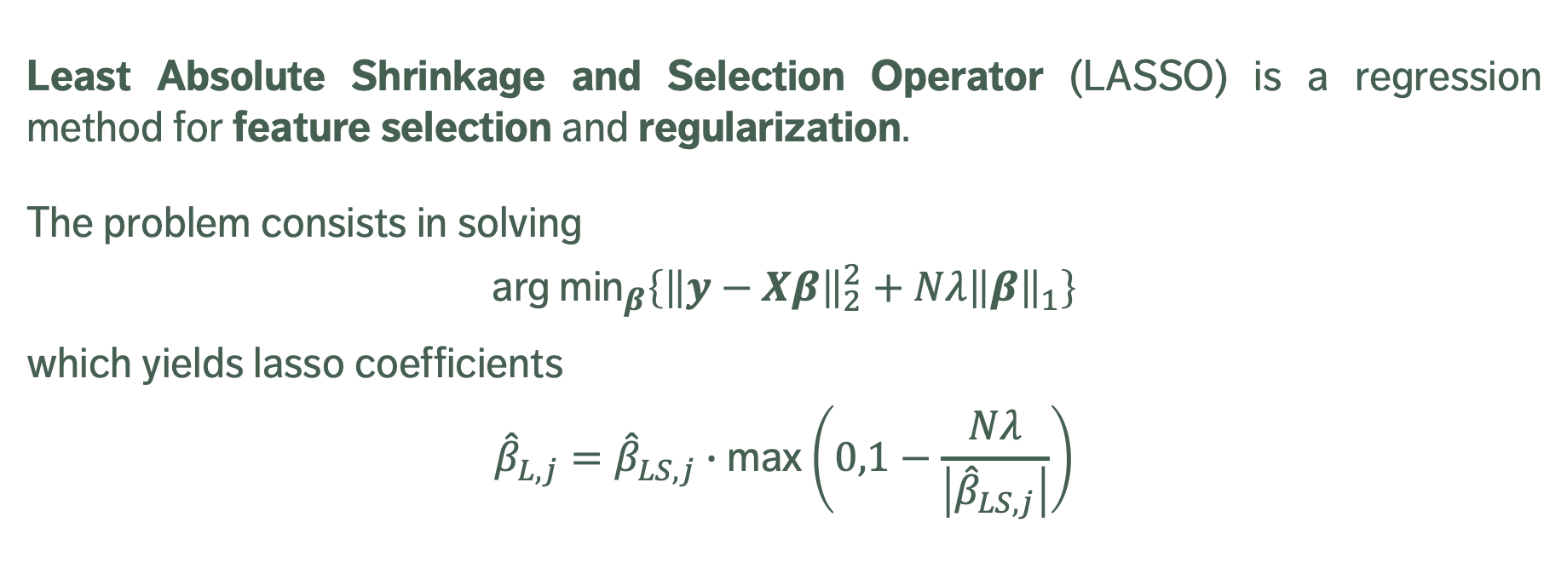
LASSO and Variants
Least Absolute Shrinkage and Selection Operator (LASSO) is a regression method for feature selection and regularization.
The problem consists in solving
$${\text{arg} \text{min}}_{β}\left\{{\left\|y−Xβ\right\|}_{2}^{2}+Nλ{\left\|β\right\|}_{1}\right\}$$
which yields lasso coefficients
$${\hat{β}}_{L,j}={\hat{β}}_{LS,j}∙\text{max}\left(0,1−\frac{Nλ}{\left|{\hat{β}}_{LS,j}\right|}\right)$$

Slide 27
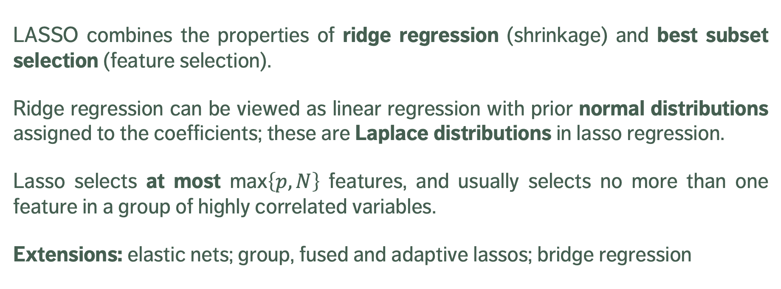
LASSO and Variants
LASSO combines the properties of ridge regression (shrinkage) and best subset selection (feature selection).
Ridge regression can be viewed as linear regression with prior normal distributions assigned to the coefficients; these are Laplace distributions in lasso regression.
Lasso selects at most $\text{max}\left\{p,N\right\}$ features, and usually selects no more than one feature in a group of highly correlated variables.
Extensions: elastic nets; group, fused and adaptive lassos; bridge regression

Slide 28
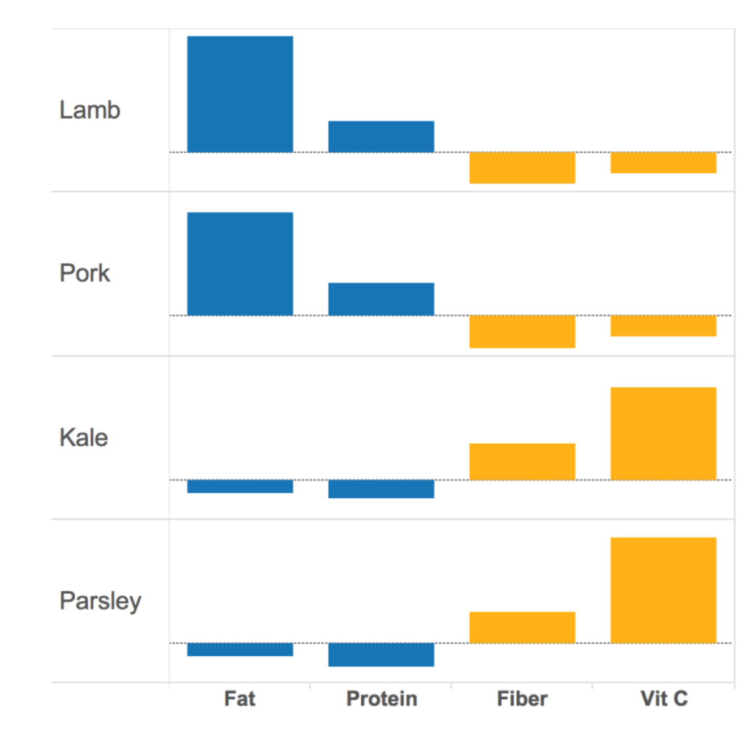
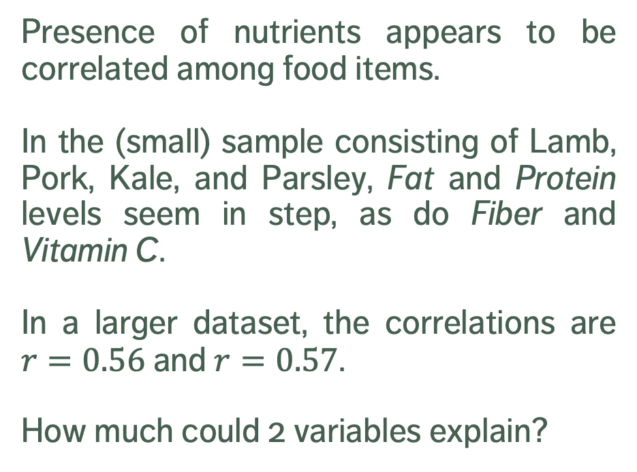
Principal Components
[A. Ng, K. Soo, Numsense!]
Presence of nutrients appears to be correlated among food items.
In the (small) sample consisting of Lamb, Pork, Kale, and Parsley, Fat and Protein levels seem in step, as do Fiber and Vitamin C.
In a larger dataset, the correlations are $r=0.56$ and $r=0.57$.
How much could 2 variables explain?

Slide 29
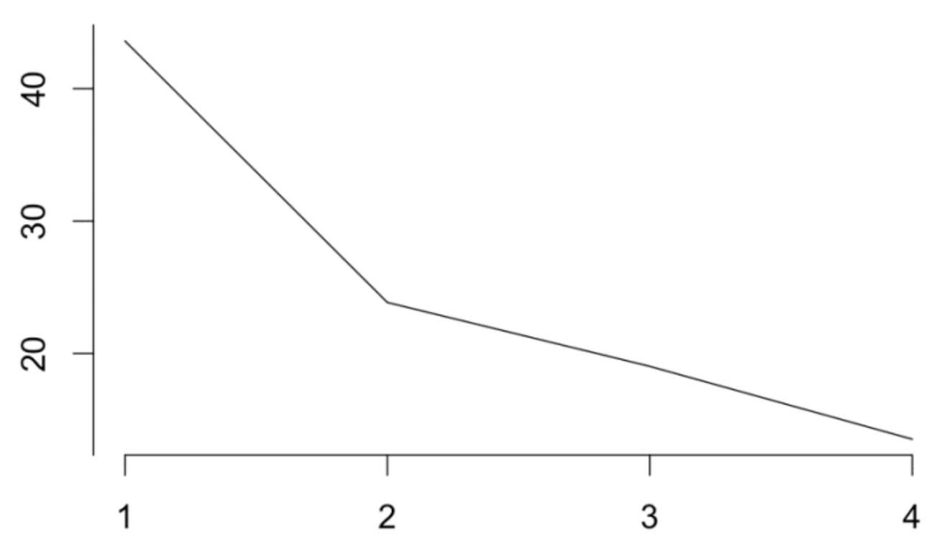
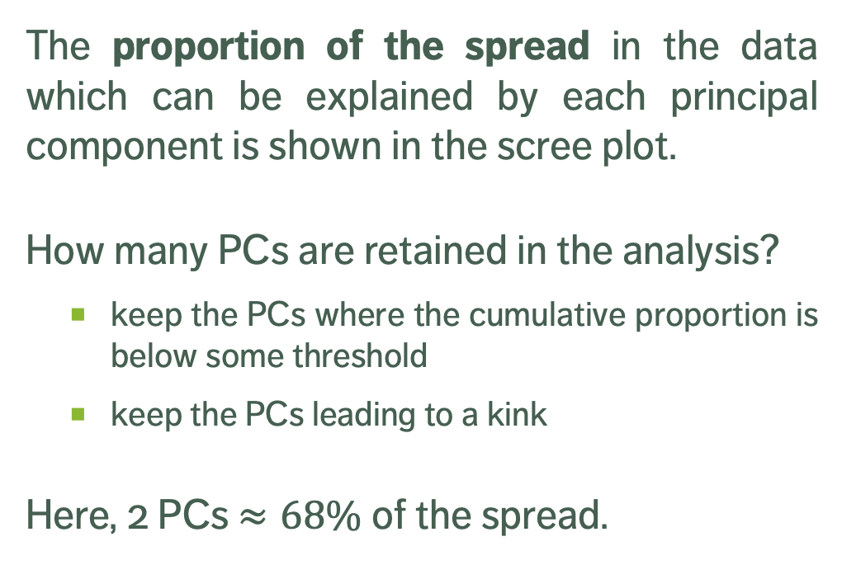
Retaining Principal Components
[A. Ng, K. Soo, Numsense!]
The proportion of the spread in the data which can be explained by each principal component is shown in the scree plot.
How many PCs are retained in the analysis?
keep the PCs where the cumulative proportion is below some threshold
keep the PCs leading to a kink
Here, 2 PCs $≈68\%$ of the spread.

Slide 30
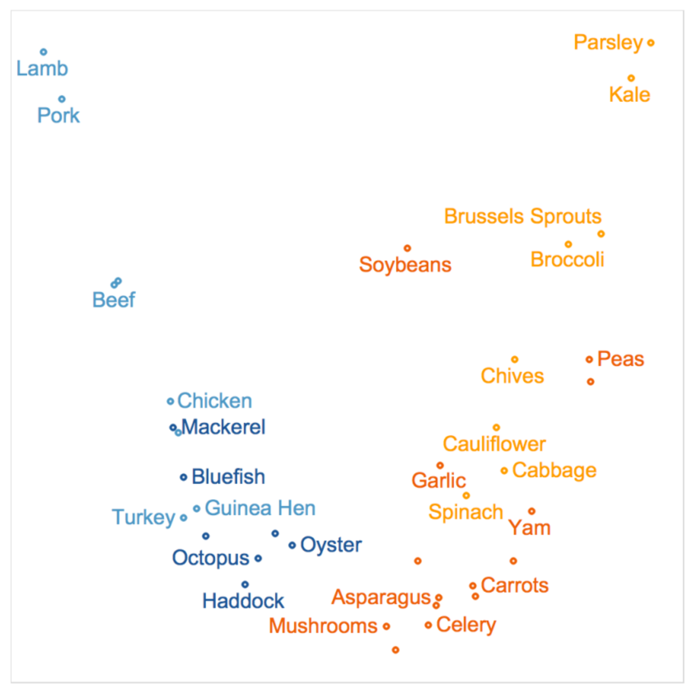
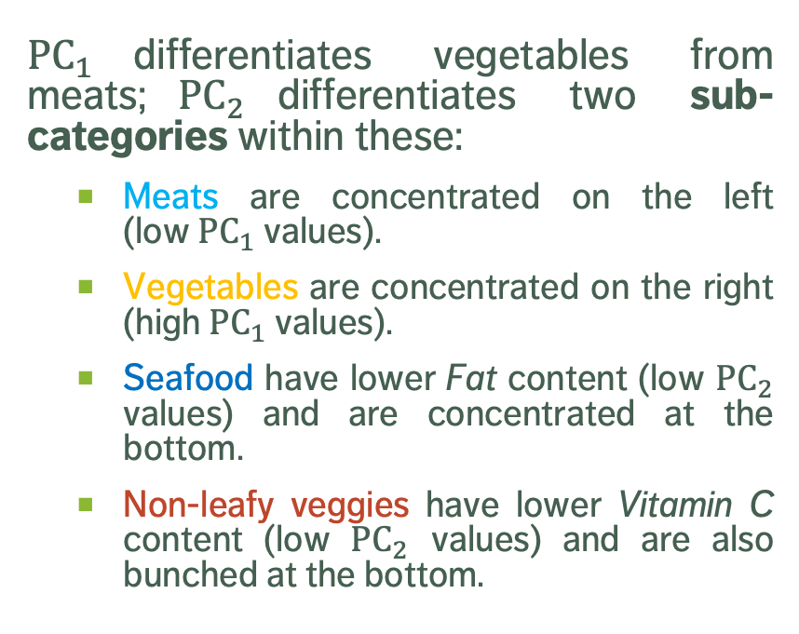


DIFFERENTIAION (REPRISE)
$${\text{PC}}_{2}$$
${\text{PC}}_{1}$differentiates vegetables from meats;${\text{PC}}_{2}$differentiates two sub-categories within these:
Meats are concentrated on the left (low ${\text{PC}}_{1}$ values).
Vegetables are concentrated on the right (high ${\text{PC}}_{1}$ values).
Seafood have lower Fat content (low ${\text{PC}}_{2}$ values) and are concentrated at the bottom.
Non-leafy veggies have lower Vitamin C content (low ${\text{PC}}_{2}$ values) and are also bunched at the bottom.
$${\text{PC}}_{1}$$

Slide 31
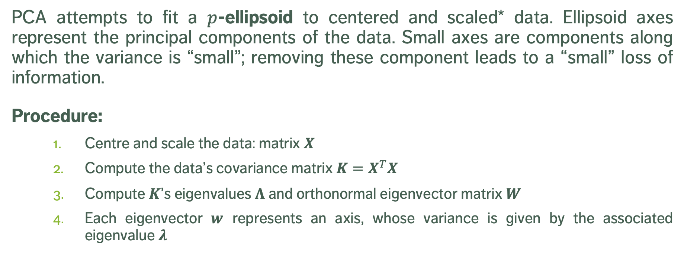
PCA in Theory
PCA attempts to fit a $p$-ellipsoid to centered and scaled* data. Ellipsoid axes represent the principal components of the data. Small axes are components along which the variance is “small”; removing these component leads to a “small” loss of information.
Procedure:
Centre and scale the data: matrix $X$
Compute the data’s covariance matrix $K=X^{T}X$
Compute $K$’s eigenvalues $Λ$ and orthonormal eigenvector matrix $W$
Each eigenvector $w$ represents an axis, whose variance is given by the associated eigenvalue $λ$

Slide 32
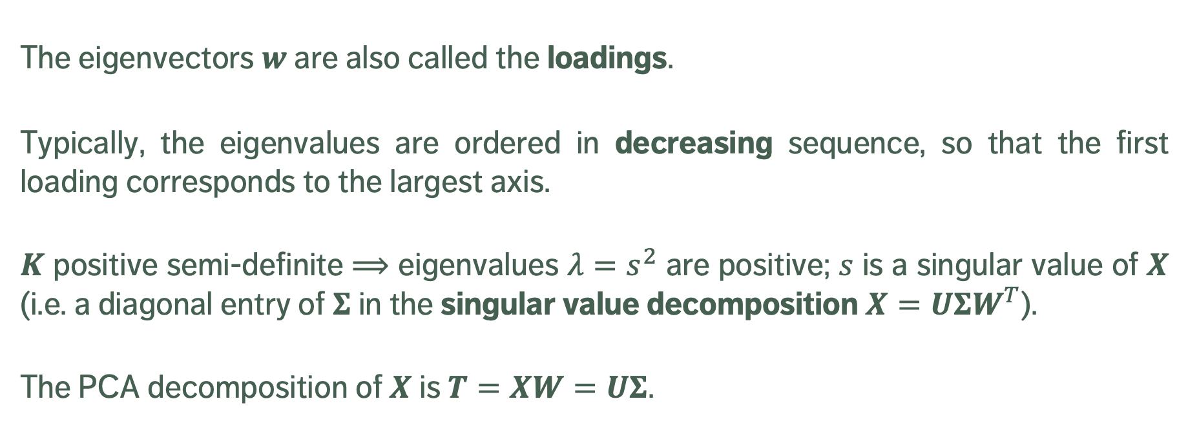
PCA in Theory
The eigenvectors $w$ are also called the loadings.
Typically, the eigenvalues are ordered in decreasing sequence, so that the first loading corresponds to the largest axis.
$K$ positive semi-definite $⟹$ eigenvalues $λ=s^{2}$ are positive; $s$ is a singular value of $X$ (i.e. a diagonal entry of $Σ$ in the singular value decomposition $X=UΣW^{T}$).
The PCA decomposition of $X$ is $T=XW=UΣ$.

Slide 33
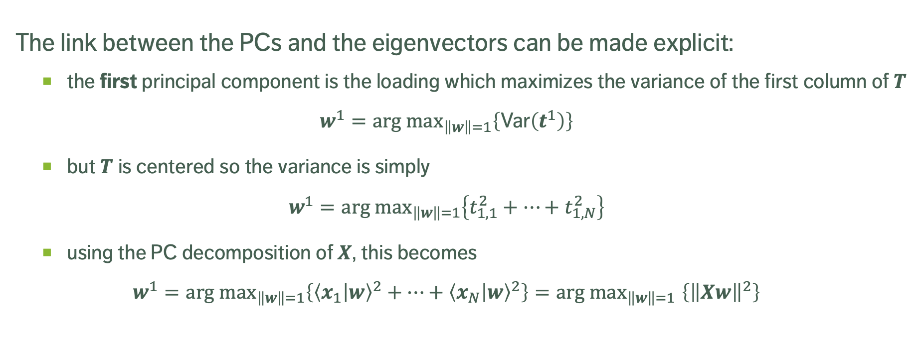
PCA in Theory
The link between the PCs and the eigenvectors can be made explicit:
the first principal component is the loading which maximizes the variance of the first column of $T$
$${w^{1}=arg \text{max}}_{\left\|w\right\|=1}\left\{\text{Var}\left(t^{1}\right)\right\}$$
but $T$ is centered so the variance is simply
$${w^{1}=arg \text{max}}_{\left\|w\right\|=1}\left\{t_{1,1}^{2}+⋯+t_{1,N}^{2}\right\}$$
using the PC decomposition of $X$, this becomes
$${w^{1}=arg \text{max}}_{\left\|w\right\|=1}\left\{{\left\langle x_{1} | w\right\rangle }^{2}+⋯+{\left\langle x_{N} | w\right\rangle }^{2}\right\}{=arg \text{max}}_{\left\|w\right\|=1}\left\{{\left\|Xw\right\|}^{2}\right\}$$

Slide 34
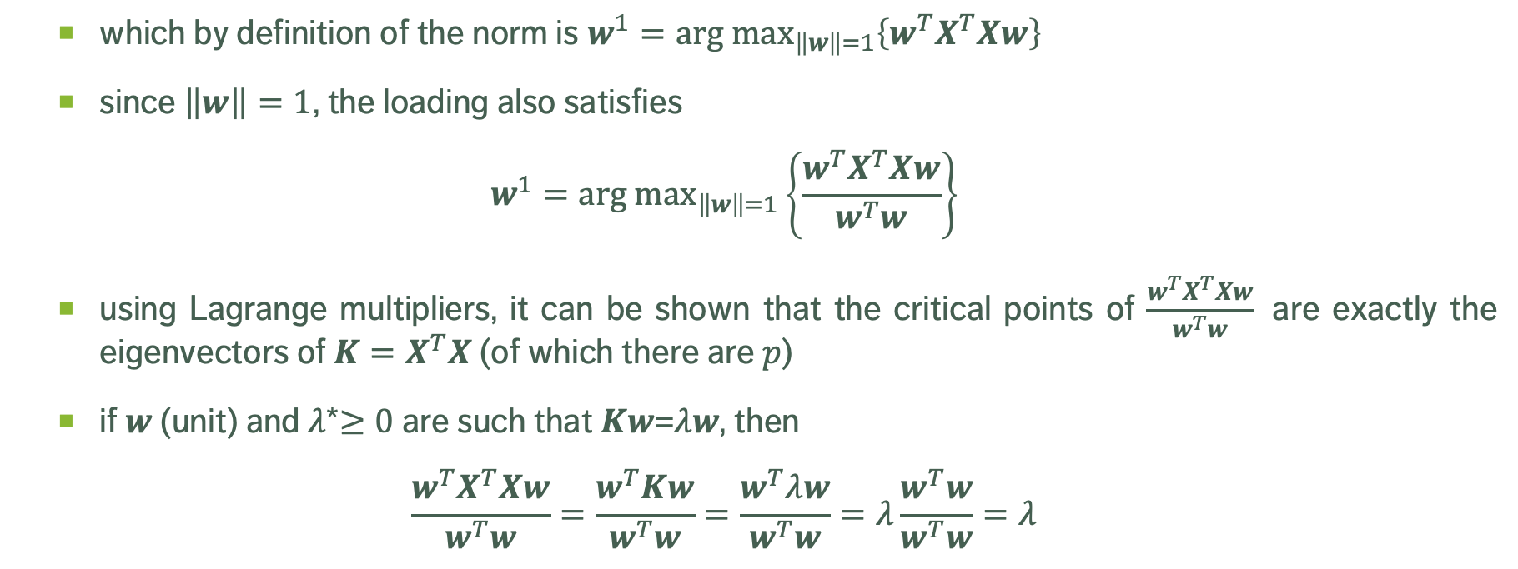
PCA in Theory
which by definition of the norm is ${w^{1}=arg \text{max}}_{\left\|w\right\|=1}\left\{w^{T}X^{T}Xw\right\}$
since $\left\|w\right\|=1$, the loading also satisfies
$${w^{1}=arg \text{max}}_{\left\|w\right\|=1}\left\{\frac{w^{T}X^{T}Xw}{w^{T}w}\right\}$$
using Lagrange multipliers, it can be shown that the critical points of $\frac{w^{T}X^{T}Xw}{w^{T}w}$ are exactly the eigenvectors of ${K=X}^{T}X$ (of which there are $p$)
if $w$ (unit) and $λ$*$≥0$ are such that $Kw$=$λw$, then
$$\frac{w^{T}X^{T}Xw}{w^{T}w}=\frac{w^{T}Kw}{w^{T}w}=\frac{w^{T}λw}{w^{T}w}=λ\frac{w^{T}w}{w^{T}w}=λ$$

Slide 35
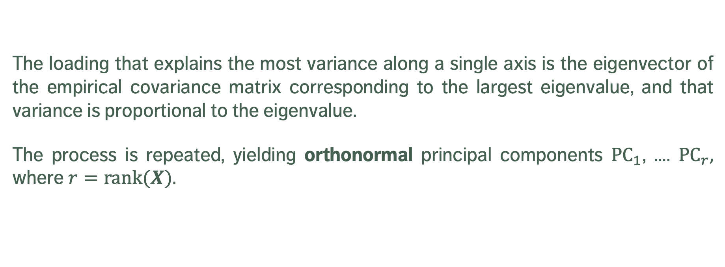
PCA NOTES
The loading that explains the most variance along a single axis is the eigenvector of the empirical covariance matrix corresponding to the largest eigenvalue, and that variance is proportional to the eigenvalue.
The process is repeated, yielding orthonormal principal components ${\text{PC}}_{1}$, …. ${\text{PC}}_{r},$ where $r=\text{rank}(X)$.

Slide 36
Generalizations
Nonlinear PCA-like methods attempt to find principal manifolds.
self-organizing maps
auto-encoders
curvilinear component analysis
manifold sculpting
Rather than reducing the dimensionality, we may expand it with kernel PCA (this is equivalent to replacing the usual inner product by more exotic objects).

Slide 37
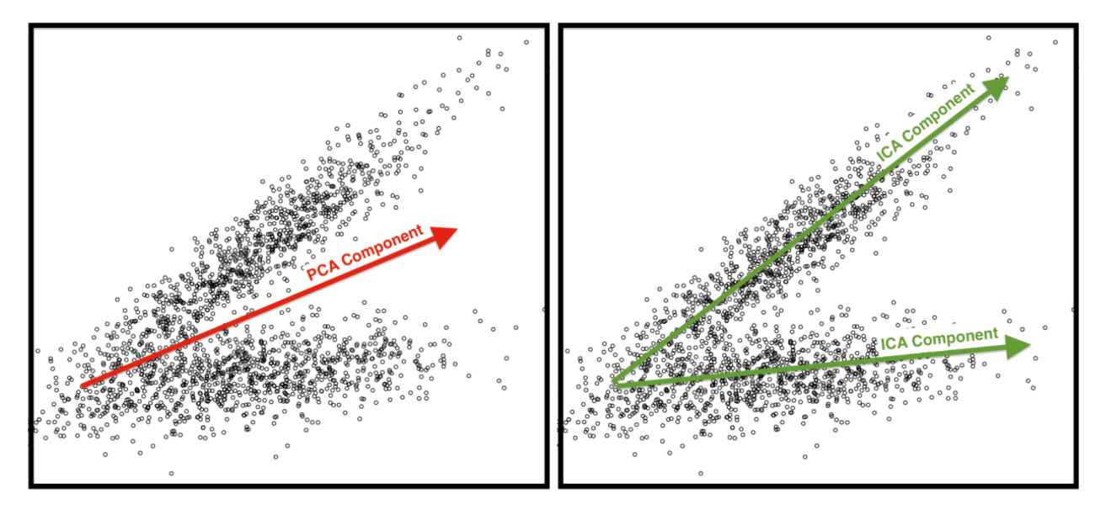
Limitations
PCA is dependent on scaling (not unique).
With no prior domain expertise, interpreting PCs may be difficult.
Assumptions are not always met
important structures and spread are correlated (i.e. counting pancakes)
PCs are orthogonal (what about ICA?)
change of basis framework (i.e. Ferris wheel tracking)
Sensitive to outliers.

Slide 38
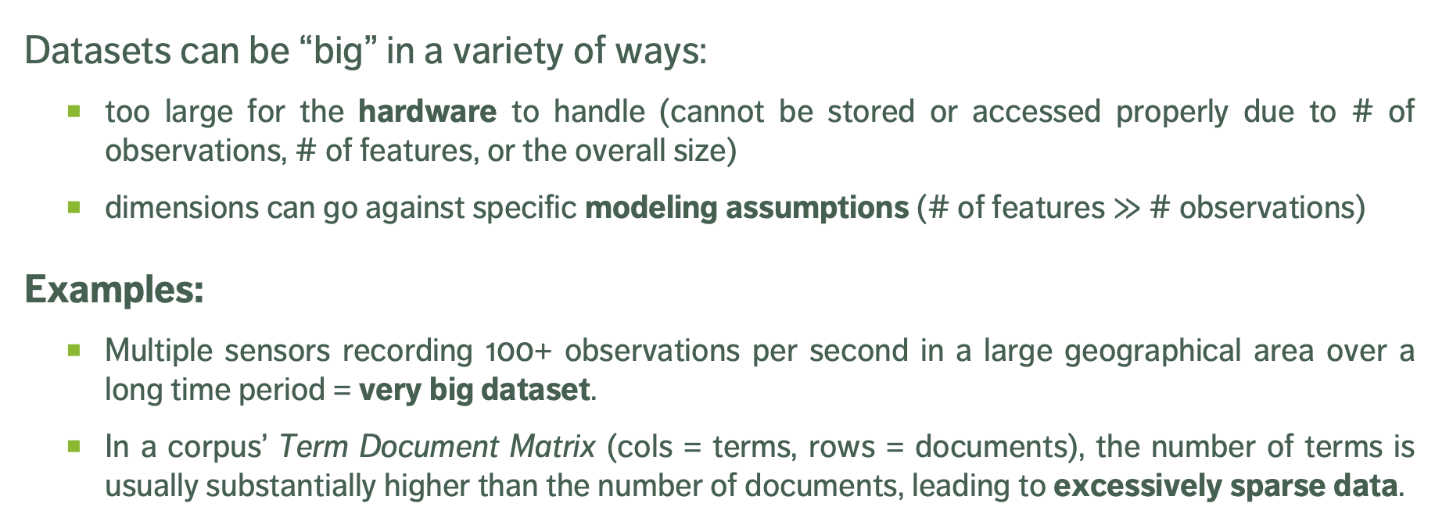
HiGH Dimensionality AND ‘BiG’ Data
Datasets can be “big” in a variety of ways:
too large for the hardware to handle (cannot be stored or accessed properly due to # of observations, # of features, or the overall size)
dimensions can go against specific modeling assumptions (# of features $≫$ # observations)
Examples:
Multiple sensors recording 100+ observations per second in a large geographical area over a long time period = very big dataset.
In a corpus’ Term Document Matrix (cols = terms, rows = documents), the number of terms is usually substantially higher than the number of documents, leading to excessively sparse data.

Slide 39
FEATURE SELECTION Methods
Filter methods inspect each variable individually and score them according to some importance metric.
The less relevant features (i.e. importance score below some set threshold) are then removed.
Wrapper methods seek feature subsets for which the evaluation criterion used by the eventual analytical method is “optimized”.
The process is iterative, and typically computationally intensive: candidate subsets are used in the analysis until one produces an acceptable evaluation metric for the analysis.

Slide 40
FEATURE SELECTION Methods
Unsupervised methods determine the importance of a feature based only on its values.
Supervised methods evaluate each feature’s importance by studying the relationship with a target feature (correlation, etc.)
Wrapper methods are usually supervised.
Unsupervised filter methods: removing constant variables, ID-like variables (different on all observations), features with low variability, etc.

Slide 41
Supervised Filter Methods
Correlation between a feature $X$ and a target variable $Y$:
$$ρ_{X,Y}=\frac{\sum_{i=1}^{N}{\left(y_{i}−\overline{y}\right)}\left(x_{i}−\overline{x}\right)}{\sqrt{\sum_{i=1}^{N}{{\left(y_{i}−\overline{y}\right)}^{2}}}∙\sqrt{\sum_{i=1}^{N}{{\left(x_{i}−\overline{x}\right)}^{2}}}}$$
Features which are highly correlated with the target variable are retained, but this approach is limited if the relationship to the target variable is non-linear.

Slide 42
Other Supervised Metrics
Classification Tasks
Gain Ratio
Inf Gain
Gini
MDL, etc.
Regression Tasks
MSE of Mean
MAE of Mean
Relief (evaluates features simultaneously), etc.

Slide 43
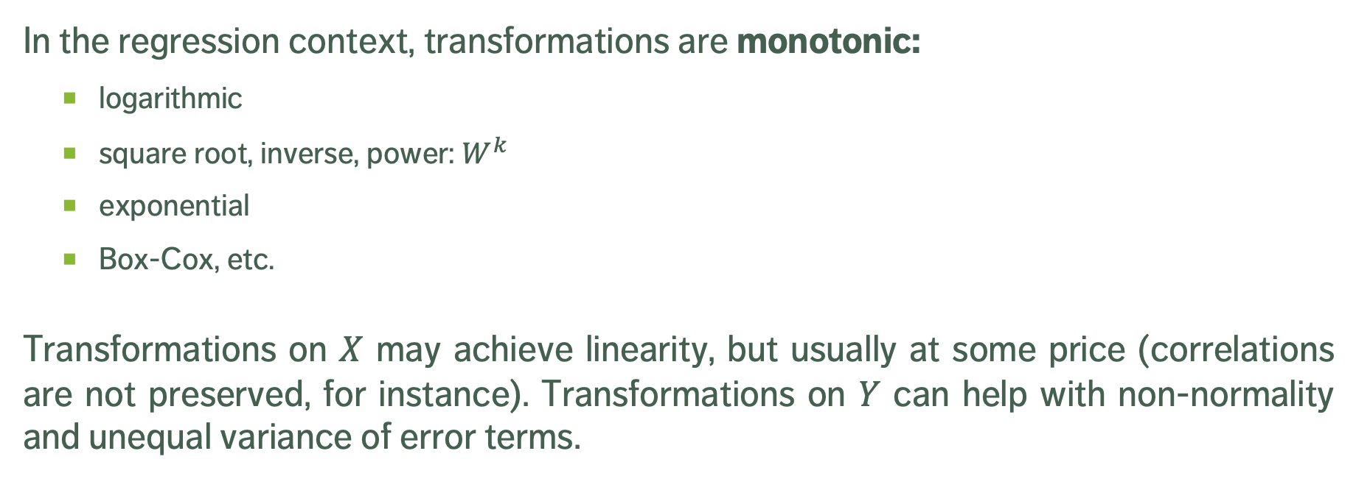
Common Transformations
In the regression context, transformations are monotonic:
logarithmic
square root, inverse, power: $W^{k}$
exponential
Box-Cox, etc.
Transformations on $X$ may achieve linearity, but usually at some price (correlations are not preserved, for instance). Transformations on $Y$ can help with non-normality and unequal variance of error terms.

Slide 44

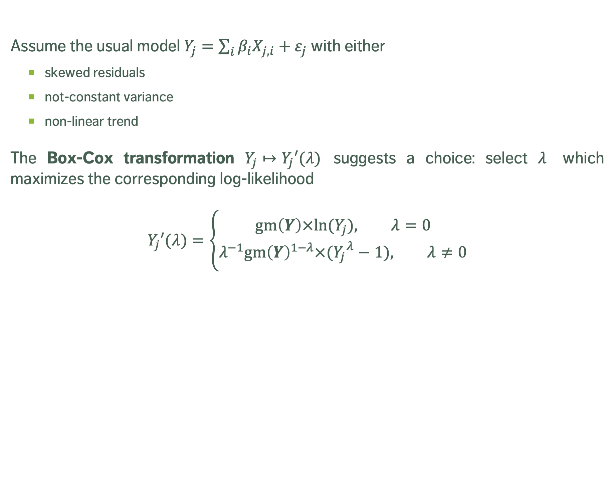
Box-Cox Transformation
$gm$ = geometric mean
Assume the usual model $Y_{j}=\sum_{i}{β_{i}X_{j,i}}+ε_{j}$ with either
skewed residuals
not-constant variance
non-linear trend
The Box-Cox transformation $Y_{j}↦Y_{j}′(λ)$ suggests a choice: select $λ$ which maximizes the corresponding log-likelihood
$$Y_{j}′(λ)=\left\{\begin{matrix}\text{g}\text{m}\left(Y\right)×ln⁡(Y_{j}), λ=0 \\ λ^{−1}{\text{g}\text{m}\left(Y\right)}^{1−λ}×({Y_{j}}^{λ}−1), λ≠0\end{matrix}\right.$$

Slide 45
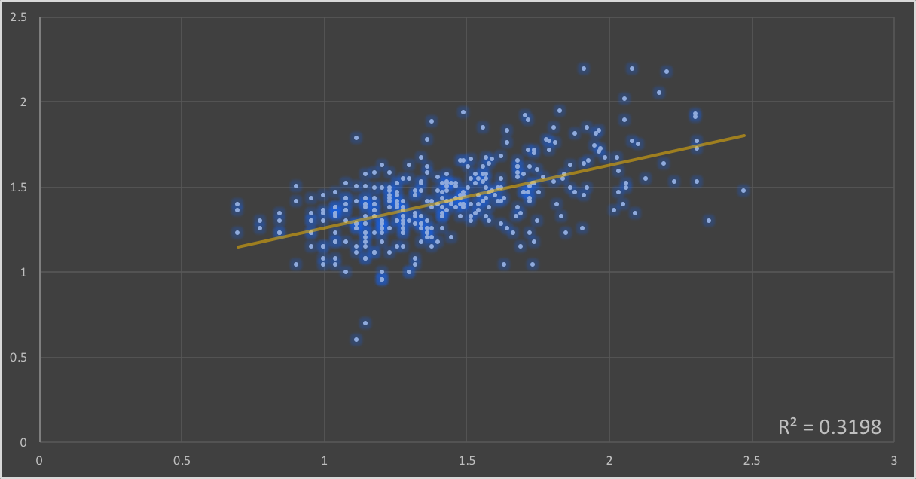
Logarithm (Box-Cox)

Slide 46
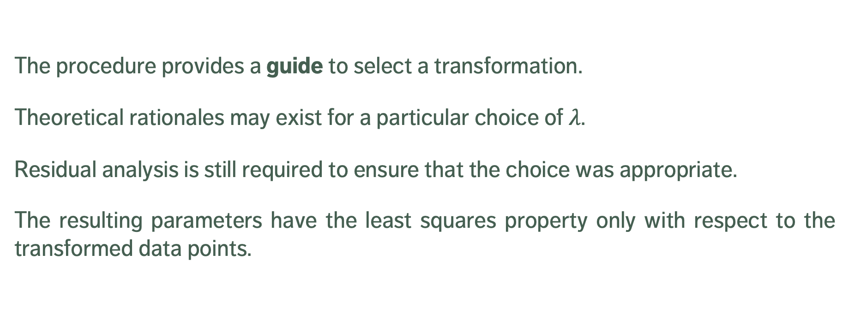
Box-Cox Transformation
The procedure provides a guide to select a transformation.
Theoretical rationales may exist for a particular choice of $λ$.
Residual analysis is still required to ensure that the choice was appropriate.
The resulting parameters have the least squares property only with respect to the transformed data points.

